Slide 1
Water in UN Initiatives
Dr. Olcay Ünver, Deputy Director
FAO Land and Water Division

Slide 2

The UN and the 2030 Agenda for Sustainable Development

Slide 3
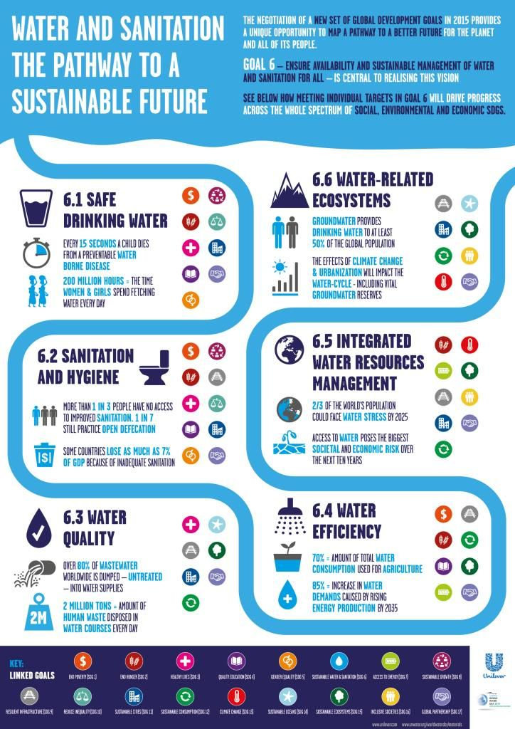
A dedicated Goal for water: SDG 6
Notes:
Target 6.4: “By 2030, substantially increase water-use efficiency across all sectors and ensure sustainable withdrawals and supply of freshwater to address water scarcity and substantially reduce the number of people suff­ering from water scarcity”

Slide 4


The UN System and the SDG 6
Notes:
- It provides the platform to address the cross-cutting nature of water and maximize system-wide coordinated action and coherence.

Slide 5

Integrated monitoring of water and sanitation - GEMI
A coherent monitoring framework with improved data acquisition and analysis to track progress and provide a platform for action.
Supported by the Swiss and German Governments.
Notes:
Objectives 1. Enlarge and complement existing successful efforts of monitoring water issues; 2. Provide the necessary evidence of feasibility and measurability of targets under a global water and sanitation goal and align data collection and reporting; 3. Fill the gaps in the existing monitoring framework in an efficient way; 4. Provide policy- and decision-makers at the national and international level with a basis to make informed decisions in the allocation of resources for activities to achieve the water and sanitation related SDG targets; 5. Explore options to cross-link proposed SDG 6 targets/indicators to water and sanitation associated targets/indicators under other SDGs, with a view to achieving optimal efficiencies and synergies in overall SDG monitoring.

Slide 6
GEMI: Indicator Lead Agencies
6.1.1 | WHO / UNICEF
6.2.1 | WHO / UNICEF
6.3.1 | WHO / HABITAT
6.3.2 | UNEP
6.4.1 | FAO
6.4.2 | FAO
6.5.1 | UNEP
6.5.2 | UNECE / UNESCO-IHP
6.6.1 | UNEP
6.a.1 | WHO / UNEP / OECD
6.b.1 | WHO / UNEP / OECD

Slide 7
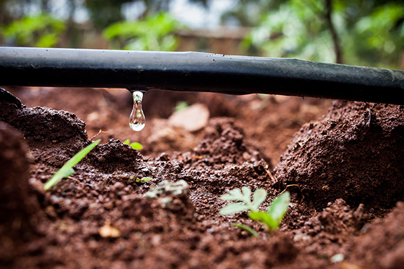
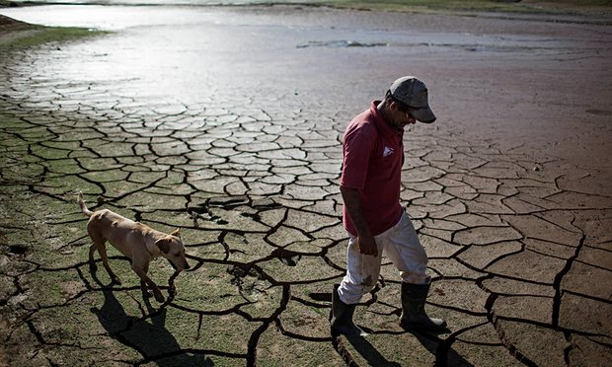
FAO: Indicators 6.4.1 and 6.4.2
Percentage change in water use efficiency over time
Level of water stress: freshwater withdrawal in percentage of available freshwater resources

Slide 8
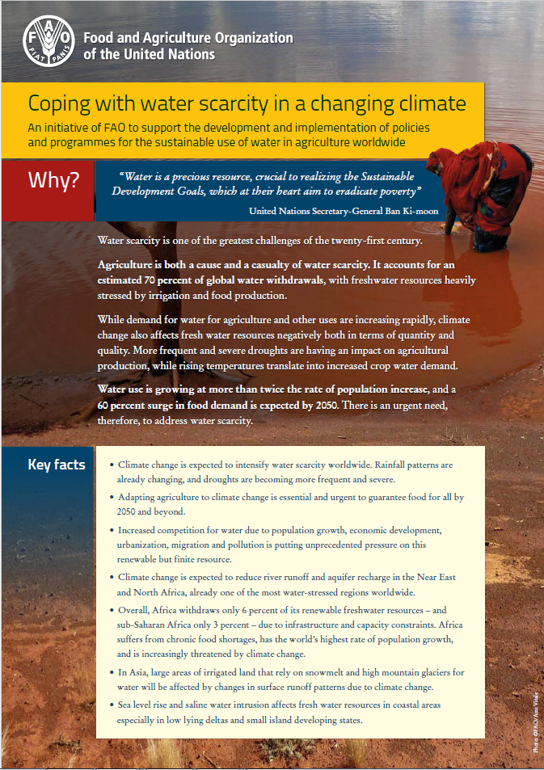
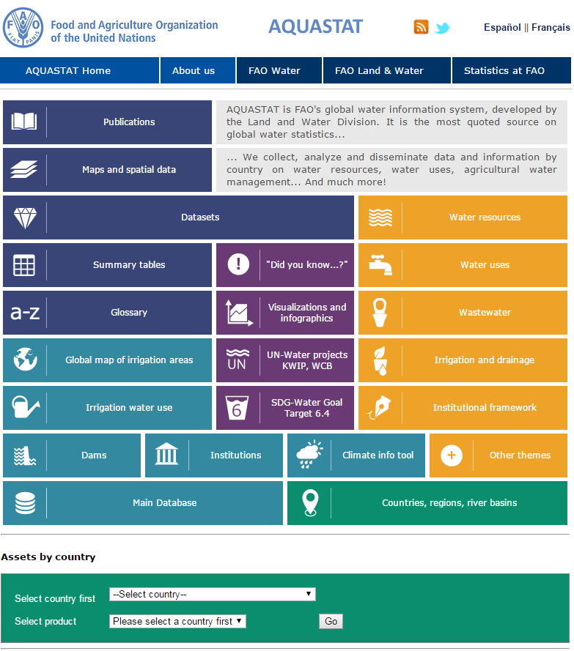
Water at FAO

Slide 9
Selected work on water
Drought Risk Management
Groundwater Governance
Water Tenure
Integrated water-soil quality monitoring
Water for the Rural Poor
Irrigation Management
Solar-powered Irrigation

Slide 10
Thank you!

